Slide 1
Software Architecture
Reactive Apps

Slide 2
A new programming paradigm
“REACTIVE”

Slide 3
The Reactive Manifesto
Check:
  https://www.reactivemanifesto.org/

Slide 4
The Reactive Manifesto
Responsive – systems should respond in a timely manner
Message Driven – systems should use async message-passing between components to ensure loose coupling
Elastic – systems should scale and stay responsive under high load
Resilient – systems should stay responsive when some components fail

Slide 5
Functional programming
Building software by composing pure functions, avoiding shared state, mutable data, and side-effects.

Slide 6
Reactive Programming
Asynchronous
Event-driven
Non-blocking
Low footprint:
  Less Memory
  Small number of threads (easy to scale vertically within the JVM)

Slide 7
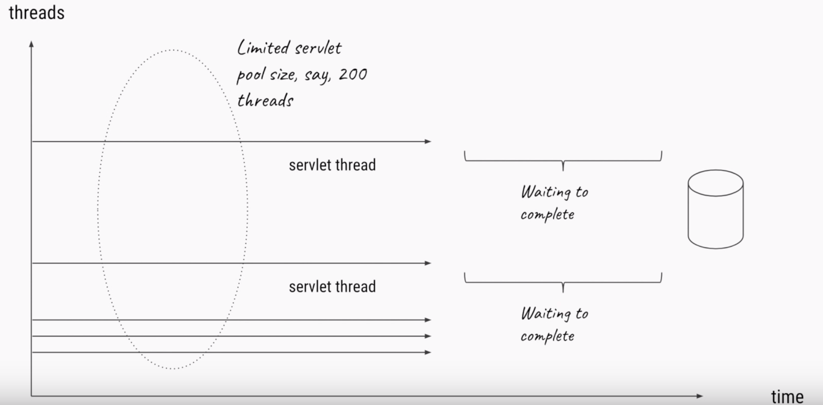
Non-Blocking
https://www.youtube.com/watch?v=M3jNn3HMeWg
Blocking IO operation

Slide 8
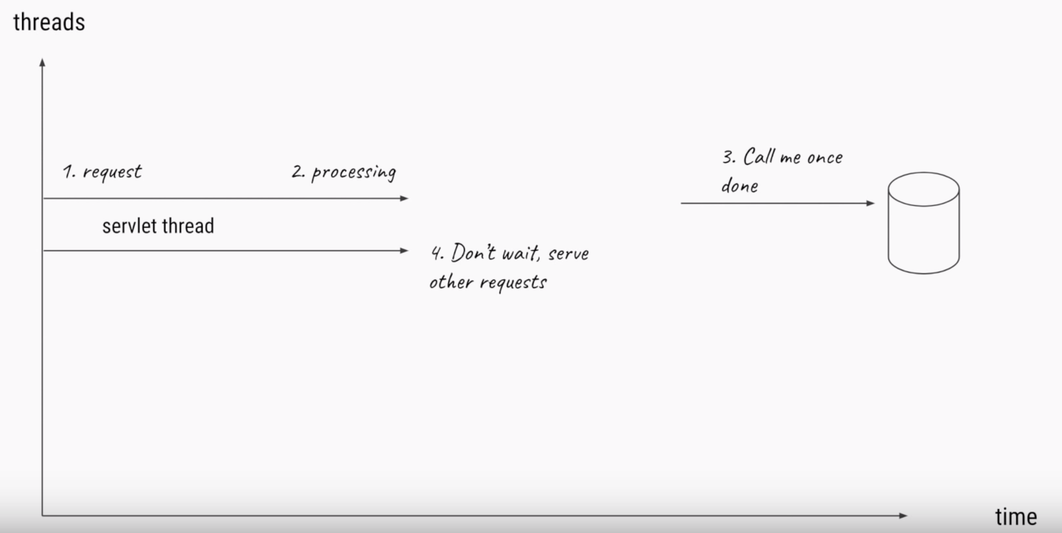
Non-Blocking
https://www.youtube.com/watch?v=M3jNn3HMeWg
Non blocking operation

Slide 9
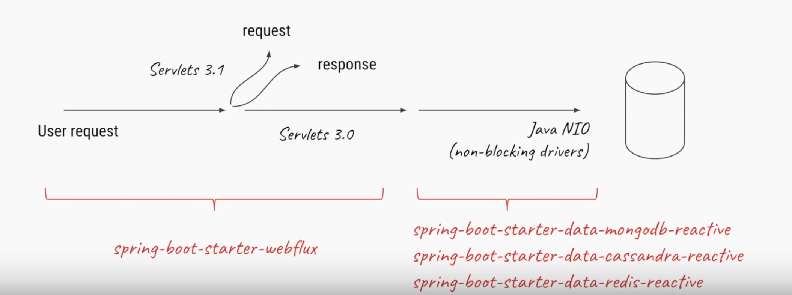
Non-Blocking
https://www.youtube.com/watch?v=M3jNn3HMeWg
Non blocking DB drivers

Slide 10

Back Pressure
Drinking from the fire hose ?!
http://renandhiedi.com/workwith/wrong-with-me/

Slide 11
Back Pressure
Ensure producers don’t overwhelm consumers.
A pipeline of reactive components between A DB to restful HTTP service :
  When the HTTP connection is too slow → the DB (sender) slow/stop pushing data until network capacity frees up.

Slide 12
Key Benefits
Applications are much more resilient and predictable under load or during scaling
  Due to low threads/memory usage
Suitable for streaming APIs
In scenarios where there’s a lot of unpredictable latencies between components
  Back pressure optimizes the flow rate and minimizes failures

Slide 13
Cons
Learning curve
To fully utilize, the whole pipeline must be reactive as well
May be too much for simple CRUD operations
Not suitable for CPU intensive operation
  Non blocking (e.g. IO) doesn’t apply

Slide 14
Reactive Programming style
Reactive Programming: Why It Matters | Andre Staltz
  https://www.youtube.com/watch?v=49dMGC1hM1o

Slide 15
Reactive Streams
Java Spec:
  https://www.reactive-streams.org/
Most of frameworks are built on top of it
Non Blocking, Back pressure
Low latency, high throughput

Slide 16
Reactive frameworks
Check Rx*: http://reactivex.io/
  RxJava (Obervable)
Spring WebFlux
  Based on Reactor: https://projectreactor.io/
Scala: AKKA (Actor Model)

Slide 17
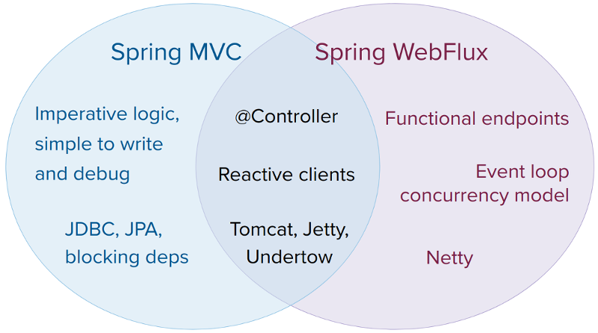
Classical MVC vs reactive
https://docs.spring.io/spring/docs/current/spring-framework-reference/web-reactive.html

Slide 18
Do I need reactive?
How to choose ?
  https://docs.spring.io/spring/docs/current/spring-framework-reference/web-reactive.html#webflux-framework-choice

Slide 19
Example reactive service in spring Webflux
Got time ? , watch GOTO 2019 • Reactive Spring | Josh Long
  https://www.youtube.com/watch?v=1F10gr2pbvQ
Note: This is an extensive example, you won’t need all of it.
  https://developer.okta.com/blog/2018/09/24/reactive-apis-with-spring-webflux

Slide 20
Reactive Programming
Learn to think in reactive way:
  The introduction to Reactive Programming you’ve been missing by André Staltz
    https://gist.github.com/staltz/868e7e9bc2a7b8c1f754
Seriously read it!

